Slide 1
Predicting Whether Demand for a Product is Favorable to Price Increases
Prepared by: Jonathan Grotts
Dataset: Online Retail.xlsx
Date: 12/22/2016

Slide 2
Contents
Purpose
Data overview
Labelling
Prediction
Conclusions

Slide 3
Original prompt
The goal is to estimate the impact of price on customer purchase by country and product purchase.

Slide 4
Purpose
Based on sales data, determine if we can predict whether the demand for a product will be unaffected or favorable after a price increase.
Items will be classified into "price change favorable" and "price change unfavorable" and then we will see if country and/or product description can predict this grouping.

Slide 5
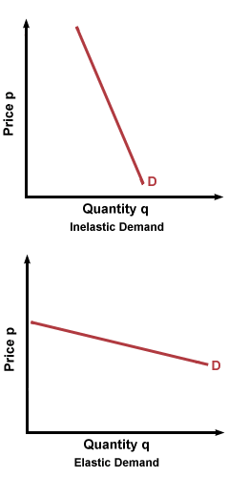
Demand curve
Elasticity = (% Change in Quantity)/(% Change in Price)
Price elasticity of demand is responsiveness of the quantity demanded of a good to a change in its price.

Slide 6
Data SOURCE
This is a transnational data set which contains all transactions for a UK-based online retail. The company mainly sells unique all-occasion gifts. Many customers of the company are wholesalers.
Dataset contained:
Unique invoice number
Unique item number
Description of product
Quantity of product sold
Invoice date
Price
Country of sale

Slide 7
Data cleaning
2 order items were removed because of negative price.
446 order items were removed because of 'Unspecified' country.
9,288 order items were removed because of negative quantities. 2 were removed because quantity was extreme outlier. These values had a quantity of approximately 81,000 and the next closest order was 4,800.
Large price outliers were investigated and left in the dataset because there was no clear indication that these were data entry errors. Also, considered removing items with descriptions like "AMAZON FEE", "Adjust bad debt", "Postage", and "Manual", but these items were left in for the analysis.
Products with only one price were removed from the analysis because a demand curve could not be drawn (n = 1,084).

Slide 8
Summary Statistics
There were 37 countries in the dataset.
There were 4,333 customers in the dataset. There were 132,018 order/item pairs missing a customer ID.
There were 3,921 unique items in the dataset.
There were 19,945 unique orders in the dataset.
The date range for the orders was 12/01/2010 - 10/12/2011. There were 302,155 order items missing an order date.

Slide 9
Summary Statistics
Shiny app

Slide 10
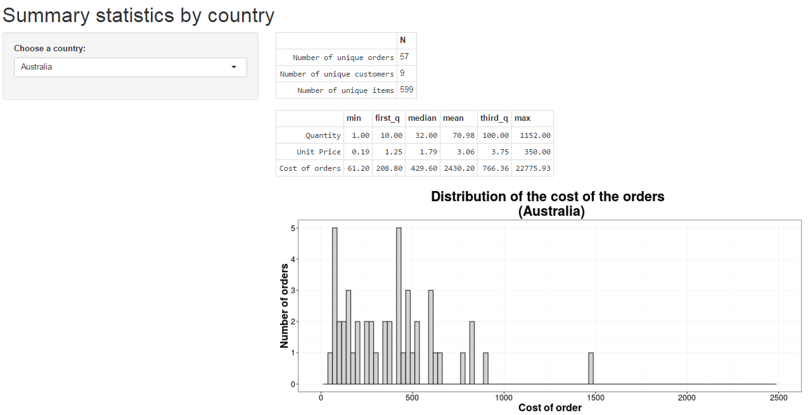

Slide 11
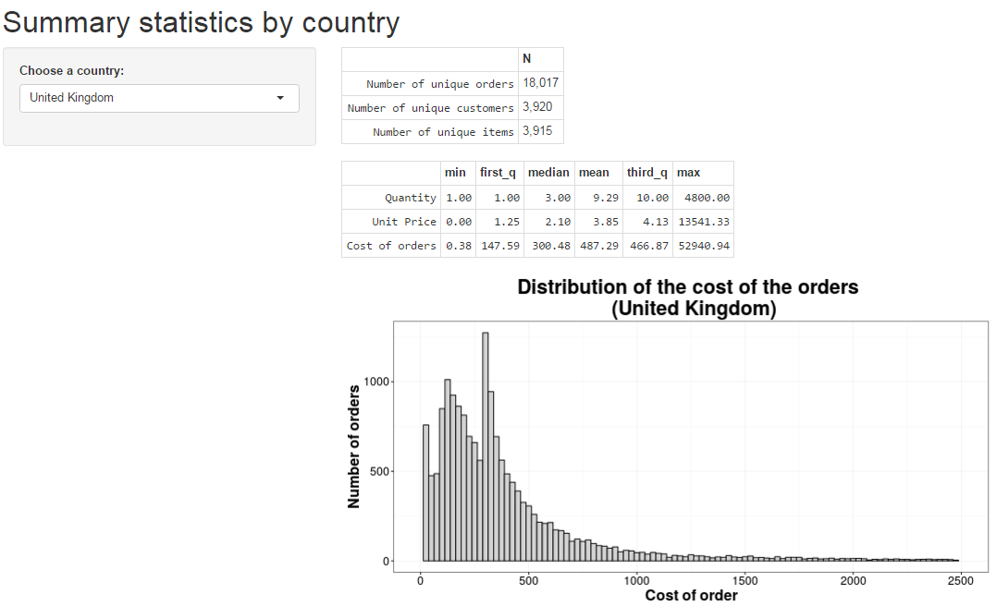

Slide 12
Feature Extraction
Price range
Quantity range
Demand curve slope
Proxy for seasonality of item sold: interquartile range of the scaled number of quantities by month
Median price and median quantity per order
Country the item sold in
Keyword from description of item

Slide 13


Slide 14
Formatted Dataset
Product by row with 2,837 items
15 keyword categories
36 countries

Slide 15
Labeling
Steps:
Explore the data
Compare clustering algorithms
Apply clustering algorithms

Slide 16
Obvious scenario

Slide 17
Obvious scenario

Slide 18
Unobvious scenario

Slide 19
Unobvious scenario

Slide 20
Distribution of demand curve slope and the ratio of quantity to price

Slide 21
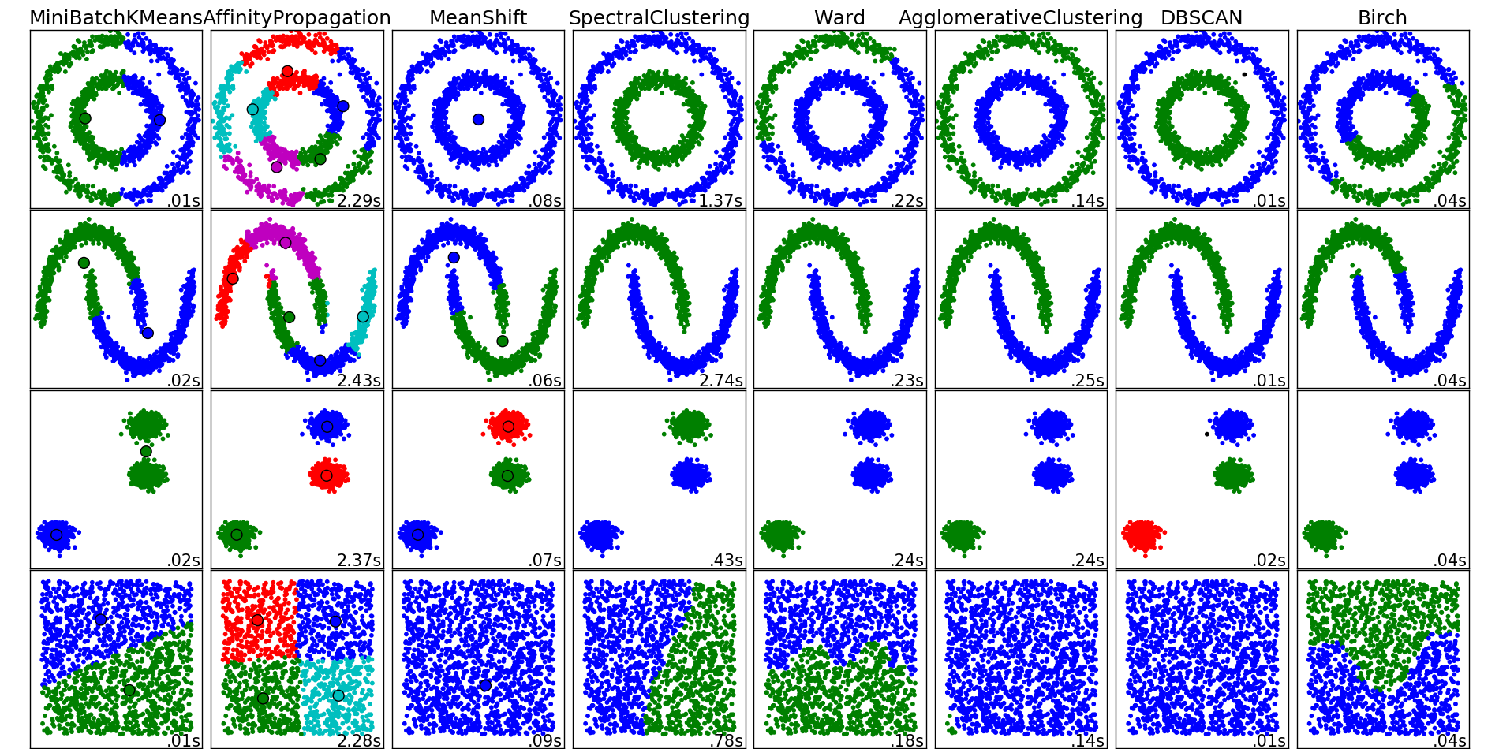
Which clustering algorithm to choose?!

Slide 22
Kmeans clustering

Slide 23
Hierarchical clustering

Slide 24
Hierarchical clustering

Slide 25
Hierarchical clustering groups

Slide 26
Summary of labelling
 | Price change unfavorable (n = 2209) | Price change favorable (n = 628)
Mean quantity | 387.6 (640.1) | 304.9 (473.1)
Median quantity | 202.4 (371.2) | 94.1 (166.8)
Price range (normalized) | 2.1 (0.3) | 2.3 (0.6)
Quantity range (normalized) | 2.1 (0.3) | 2.4 (0.7)
Demand curve slope (normalized) | -0.7 (0.2) | -0.3 (0.4)
Number of unique customers | 88.4 (91.9) | 99.7 (111.4)
Number of unique orders | 169.3 (199.7) | 201.9 (243.7)
Brazil | 21 (65.6%) | 11 (34.4%)
European Community | 30 (61.2%) | 19 (38.8%)
Poland | 134 (68.4%) | 62 (31.6%)
United Arab Emirates | 47 (72.3%) | 18 (27.7%)
United Kingdom | 2209 (77.9%) | 628 (22.1%)
design | 75 (72.1%) | 29 (27.9%)
christma | 92 (78.6%) | 25 (21.4%)
retrospot | 80 (87%) | 12 (13%)

Slide 27
Models to predict favorable price change
Logistic regression
Support vector machine (SVM)
Linear discriminant analysis
Classification and regression tree (CART)
Random forest
Generalized boosted model

Slide 28
Summary of model fitting strategy
Fit models
Train models using repeated cross validation (10 folds, 3 repeats)
Models trained based on accuracy
Compare accuracy and the kappa statistics between models
Summarize results of best performing model

Slide 29
Model performance

Slide 30
Random forest performance

Slide 31
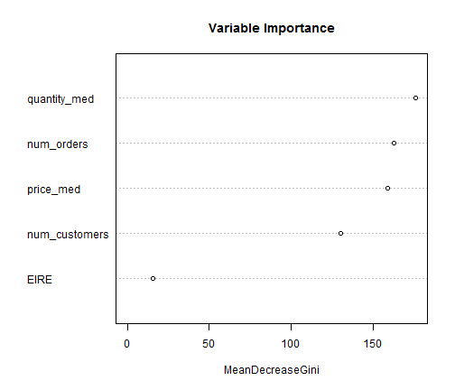
Random forest performance

Slide 32
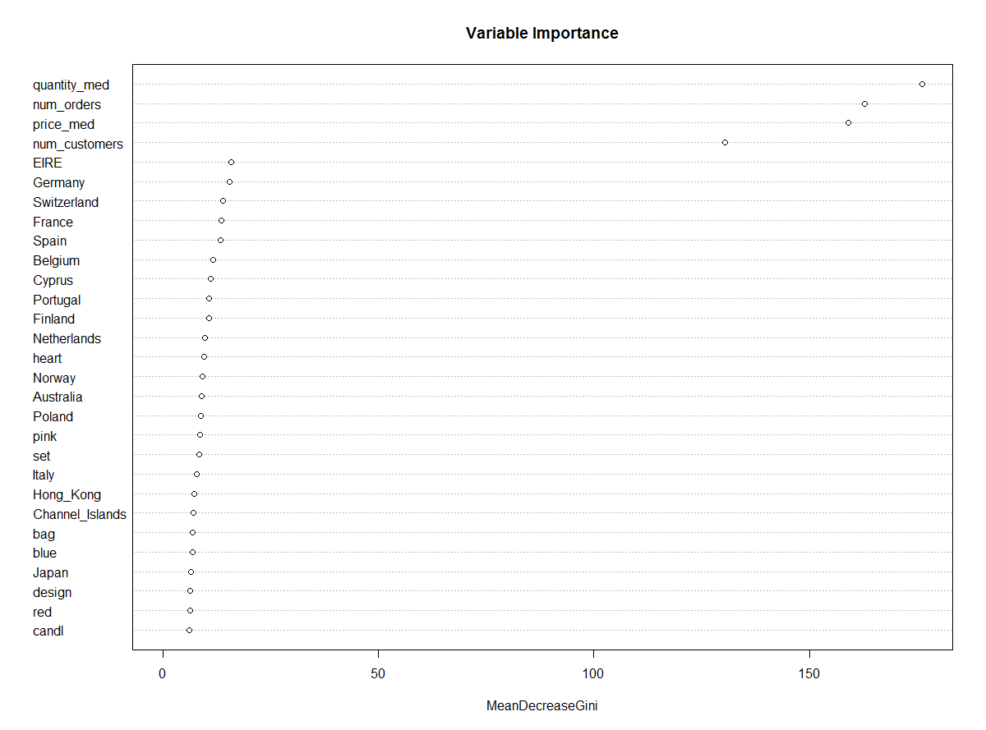

Slide 34
OR’s from logistic regression
Variable | OR (95% CI)
Median quantity | 0.996 (0.995 - 0.997)
Number of unique orders | 1.003 (1.002 - 1.005)
Japan | 0.558 (0.356 - 0.877)
Hong Kong | 0.549 (0.333 - 0.906)
Poland | 1.554 (1.073 - 2.252)
decor (keyword) | 0.502 (0.266 - 0.947)
European Community | 1.959 (1.009 - 3.802)
Denmark | 1.426 (0.972 - 2.094)
Canada | 0.626 (0.371 - 1.058)
RSA | 0.494 (0.21 - 1.162)
Saudi Arabia | 3.26 (0.742 - 14.312)
Bahrain | 0.133 (0.01 - 1.686)
Retrospot (keyword) | 0.61 (0.3 - 1.242)

Slide 35
conclusions
Whether a product is favorable to price change is most influenced by the quantity sold and the price of the product
Possible further areas of exploration:
Better metrics for seasonality
Clustering on description of products or countries sold in
Use external source to map description of products to categories
More accurate labelling

Slide 36
questions
Thank you!

